Slide 1
Development Policy Planning in Ghana
Richard Fosu
MEP15202 (MP2 Programme)
Ghana
Local Government Service

Slide 2
Outline
Brief country profile
Introduction/Basic concepts
Planning institution(s) & Mandate
Processes/activities of Planning
Policy Planning quality score (Prof. Ohno’s indicators)
Conclusion

Slide 3
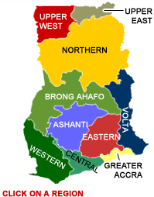
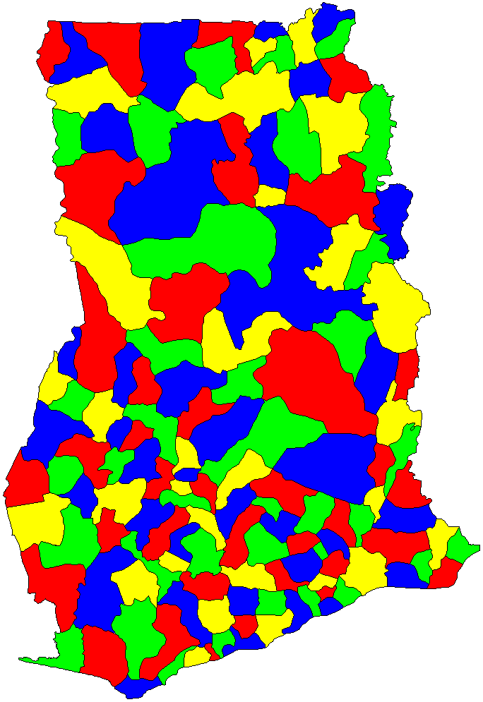
Country Profile

Slide 4
Profile Cont’d
Population | 28 million
GDP | US$ 39 billion
Per capita Income | US$ 1,417
Land Area | 238,540 km²
Population growth rate | 2.5%
Fertility rate | 4.2 (5.2 rural, 3.2 urban)
Life Expectancy | 60.21(Men) 62.13(Women
Major Exports | Cocoa, Gold, Oil, Timber
Government | Democracy (Unitary State)
Religion | Christianity (71.2%), Islam (17.6%), Traditional (5.2%), others (0.8%) and None (5.2%)

Slide 5
Components of Development Planning
Institutional arrangements
Processes
Outcomes

Slide 6
Background to Planning in Ghana
Ghana known to have completed the first development plan in the developing world or perhaps the world, the Guggisberg Plan of 1919-1926 (Tando-Offin, 2013).
Since then 12 National Plans have been completed and implementation attempted, however, short-lived due to political instability. Most of these plans were centrally planned (top-down).
Decentralization in late 1980s and subsequent return to democracy in 1992 marked a watershed in developing planning in Ghana.
This presentation focuses on development planning since 1992; especially the decentralized planning system.

Slide 7
Development Planning Post-1992
Articles 86 & 87 of the 1992 Constitution of Ghana established the National Development Planning Commission (NDPC) as the central planning agency.
The National Development Planning Commission Act, 1994 (Act 479) and the National Development Planning Systems Act, (Act 480) provides the legal basis for the NDPC and performance of it functions.
The Commission has three main divisions;
Development Policy Division
Plan Coordination Division
Monitoring and Evaluation Division
The development planning approach has not changed since 1992.
The NDPC is appointed by the president and it is under the office of the president.

Slide 8
Core Mandate of the Commission (NDPC)
The core mandate of the Commission is to “advise the President on development planning policy and strategy” and, “at the request of the President or Parliament, or on its own initiative,” do the following:
Study and make strategic analyses of macro-economic and structural reform options
Make proposals for the development of multi-year rolling plans taking into consideration the resource potential and comparative advantage of the different districts of Ghana
Make proposals for the protection of the natural and physical environment
Make proposals for ensuring the even development of the districts of Ghana by the effective utilization of available resources; and
Monitor, evaluate and coordinate development policies, programmes and projects.

Slide 9
Development Plans Post-1992
Vision 2020 (1996-2020)—Its first medium term Vision 2020: The First Step (1996-2000)
Ghana Poverty Reduction Strategy (2003-2005)—GPRS I
Growth & Poverty Reduction Strategy (2006-2009)—GPRS II
Ghana Shared Growth Development Agenda I (2010-2013)
Ghana Shared Growth Development Agenda II (2014-2017)
A proposed 40 year Development Plan ongoing (2018-2057)

Slide 10
Relationship between NDPC & MoF(EP)
Legally, the NDPC is responsible for development planning
However, the MoF have pre-eminent role in planning for historical and obvious reasons (SAPs &ERP, budgeting and lack of fiscal decentralization).
This was seen in the GPRS I & II.
The Minister of finance is a member of the commission.

Slide 11
The Decentralized Planning System
Section 1 of the National Development Planning (System) Act, 1994 (Act 480) provides for Decentralized Development Planning.
The decentralized planning system is regulated by LI and guidelines issued by the Commission.
Since the inception of the NDPC, Ghana has followed the planning regimes and prepared medium term development plans (MTDP).
Local Government Act, 1993 (Act 462) designate each District Assembly as the planning authority of its area of jurisdiction.

Slide 12
The Decentralized Planning System
National
NDPC
Sector Agencies
Ministries
Regional (RCC/RPCU)
District (DPCU)
All Decentralized Ministries/Agencies/Departments

Slide 13
The Decentralized Planning System & The (D)MTDP-Activities/Processes/Steps
Vision, mission & function
Performance Review
Analysis of existing situation/compilation of district profile
Harmonization of community aspirations with gaps identified from performance review and district profiling.
Link key development problems with thematic areas of the NMTDPF
Prioritization of adopted issues
Selection of prioritized development option
8. selection of District Development Goal
9. Adoption of District objective and strategies
10. Formulation of development programmes
11. Formulation of Composite Plan of Action
12. Preparation of Indicative financial Plan
13. Preparation of District Composite Annual
Action Plan
14. Adoption of the DMTDP
15. Implementation of Annual Action Plans
16. Monitoring and Evaluation
17. Development of District Communication strategy

Slide 14
Essence of the Planning Activities in the Decentralized Planning System
Participation
Prioritization
Consultation
Delegation
Accountability

Slide 15
Issues in the Planning Process
Merits
Demerits
Bottom-up approach
Ownership
Accountability
Good quality of inputs due to broad consultation
Cost
Institutional and citizenry fatigue
Politics-Resource allocation problem
Planning and budgeting conflicts

Slide 16
Modified Policy Quality Checklist for Planning Processes in Ghana
S/No. | Component Aspects | Assessment/Score (out of 5)
1 | Ownership of the process of planning | 4
2 | Vision & commitment of top leader(s) to the planning process | 2.5
3 | Commitment of institutions and persons to planning procedures | 4
4 | Authority and capacity of policy organization (MMDAs/MDAs) | 3
5 | Mindset & competency of planning officials | 3
6 | Budgeting and staffing | 3
7 | Inter-agency coordination in the process of planning | 3
8 | Involvement of key non-official stakeholders in planning process | 3
9 | Monitoring &evaluation mechanism | 2.5
10 | Institutional arrangements for the planning process | 4

Slide 17
Thank you very much
For
Your Attention

