Slide 1
Local Administration and Policy Implementation in Local Governments of Myanmar
Issues and Status of Local Government in Myanmar
Name : AKAR, Tin Oo
ID : MEY-15008
Program : YLP (the School of Government)
Country : The Republic of the Union of Myanmar
Affiliation: Assistant Director
General Administration Department
Ministry of Home Affairs
Date: 1st July 2016

Slide 2
Today’s Focus
Current Myanmar’s Local Administration System and Local Governments
Important Role of Central Ministry- Ministry of Home Affairs in Local
Government
Policy Implementation in Local Levels
A case study: My Experience on Policy Implementation at LG
Conclusion

Slide 3
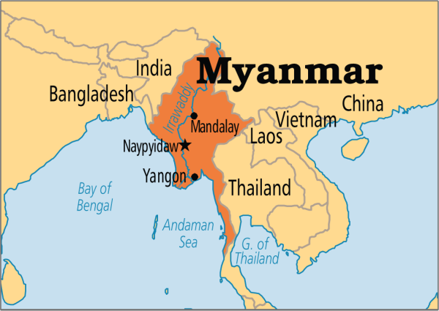
Geo & Demographic
Total area - 676,578 km
(2nd Largest Country after
Indonesia in Southeast Asia)
Population - 51.42 million (2014 census)
Independent Day - Jan 4,1948
GDP ( billions) - USD 59.44 (2012)
GDP per capita - USD 1125 (2012)
United Nations - April 19, 1948
ASEAN Member - July 23, 1997
Religious : 89.2% Buddhism
: Christianity (5.0%),
: Islam (3.8%),
: Hinduism (0.5%),
: Spiritualism (1.2%) and
: others (0.2%).
70% of population are residing in rural Areas
Over 100 national races (8 major races)

Slide 4
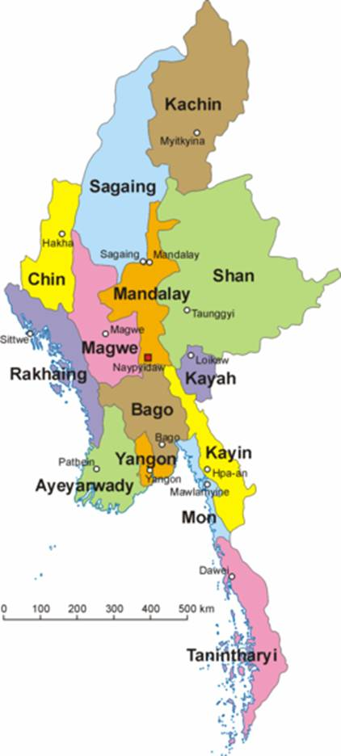
State Structure and System
Democratic Country (since 2010)
Unitary System and the President is the head of the State
Two Tires Government:
Central Government and Local Government
Chief Minister is the Head of the Local Government
14 – Local Governments
One Union territory and capital city:
Nay Pyi Taw
Yangon is former Capital City

Slide 5
Central Government Structure
The State Power
Judiciary
Executive
Legislative
Supreme Court
Courts-Martial
Constitutional Tribunal
President
Union Parliament
National Parliament (Upper House)
People’s Parliament (lower House)
Vice- Presidents
Cabinet Office
Office of the State Counsellor
Union Ministries
Attorney General Office
Auditor General Office
Union Civil Servant Board

Slide 6
Executive Branch /Administrative Structure at Central Government
Cabinet Office ( Politicians)
The President
Vice-Presidents
Union Ministers
The Attorney General of the Union.
Executive Branch
Cabinet Office
Ministries (Politicians)
Lead by Union Minsters
Some Ministries have two or more Deputy Ministers
Some Ministerial Organizations are led by Chairmen (Union Ministers Level) and members (Deputy Ministers Level)
Ministries (21) and Ministerial Organizations
Departments/ Agencies
Departments/ Agencies (Bureaucrats)
Lead by Director Generals
Director General positions are appointed by the approval of Cabinet Office.
* The President is responsible to the Union Parliament.

Slide 7
Executive Branch /Administrative Structure at Local Government
Local Cabinet Office ( Politicians)
Chief Minister
Local Ministers
The Advocate General
Executive Branch
Local Cabinet
Ministries (Politicians)
Lead by Local Minsters
Relevant Local Departments/Agencies are put under each ministries
Duties and Functions are mainly assigned by the Chief Minister
Local Ministries (9)
Departments/ Agencies (Bureaucrats)
Almost are Lead by Director Level
All of local officials and staff are appointed by the Central Government.
All of their personnel affairs are directly handling by the Central Government.
They are accountable to both Central Ministries and Local Ministries.
Local Departments/ Agencies
* The Chief Minister is responsible to the President.

Slide 8
Local Government and Local Departments for Local Public Services
Local Government Cabinet
Chief Minister (Governor)
Central Government Ministries
Minister-1
Minister-2
Minister-3
Minister-4
Minister-5
Minister-6
Minister-7
Minister-8
Minister-9
Home Affairs
LG Secretary
Agriculture
Social Welfare
State/Region Level
GAD
Health
Finance
Agriculture
Social Welfare
Planning
Forestry
Education
Planning
GAD
Health
Finance
Agriculture
Social Welfare
Planning
Forestry
Education
Education
District Level
Forestry
Township Level
GAD
Health
Finance
Agriculture
Social Welfare
Planning
Forestry
Education
Finance
W-VT offices
Local Departments
Notes:
Mechanism for Chief Minister to report.

Slide 9
The Division of Roles between Central and Local Governments
Sector | Central Government | Local Governments
Administration/ Management Sector | General Administration, Administration of town and village land, Tenants, Narcotic drugs and psychotropic substances, Union secrets, Associations, Prisons, Development of Border Areas; Citizenship, naturalization, termination and revocation of citizenship, citizenship scrutiny and registration, and Titles and honors. | Development matters, Town and housing development, Honorary certificates and awards.
Civil Servants Sector | Recruitment, Promotion, Transfer, Dismiss, Taking Action and others; | Manage, Guide, Supervise, Inspect
Education Sector | Educational curricula, syllabus, teaching methodology, research, plans, projects and standards; Universities, Degree colleges, institutes and other institutions of higher education; Examinations prescribed by the Union; Private schools and training; | Manage, Guide, Supervise, Inspect
Others | Union Defense and security sector; Foreign Affairs sector; | -
Notes:
Explain something.

Slide 10
Ministry of Home Affairs
Minister and Deputy Ministers are nominated by the Commander-in-Chief and based on nomination, the President appoints them, and of course, they are active defense service persons according to the constitution
There were no civilian ministers and deputy ministers for Home Affairs every regimes of Myanmar.
Minister
Deputy Ministers
Secretary Office of MOHA
Myanmar Police Force
General Administration Department
Bureau of Special Investigation
Prison Department
Fire Service Department
Local Police Offices
Local Administration Offices
Local Offices
Local Prisons
Local Service Forces
Force, Departments, and Bureau are led by Police Chief and Director Generals respectively, all of these higher positions are occupied by former defense service persons who retired and transferred from defense service. Minister nominates the name of the persons for those positions and the cabinet office decides and approves.

Slide 11
The structure of General Administration Department at Central and Local Level
Ministry of Home Affairs
Secretary Office of MOHA
GAD (Head Quarter)
Secretary of LG and S/R Administrator
Local Government Cabinet
GAD (State/Region Level)
GAD (District Level)
Administration in Local Governments are totally operating by GAD offices and civil servants are under the supervision of LG. But their personnel management is directly managed by the MOHA.
They are responsible and accountable to both MOHA and LGs.
The role of GAD is secured by the constitution.
District Administrator
GAD (Township Level)
Township Administrator
Ward or Village-Tract Administration Offices
W/ VT Administrator

Slide 12
The structure of General Administration Department
Administrative Level at Local Government | Head of Local Administration | Ranks and Status | Main Functions and Accountability | Remarks
State/ Region Level | State/ Region Secretary and State/Region Administrator | Deputy Director General/ Central Government Officials of MOHA | Functions of MOHA Functions of LG/ Accountable to GAD (HQ) and LG | The 2008 Constitution, Article- 260
District Level | District Administrator | Director/Central Government Officials of MOHA | Functions of MOHA Functions of LG Accountable to S/R GAD | The 2008 Constitution, Article- 288
Township Level | Township Administrator | Assistant Director /Central Government Official of MOHA | Functions of MOHA Functions of LG Accountable to District GAD | The 2008 Constitution, Article- 288
Ward or Village-Tract Level | Ward or Village-Tract Administrator | Non-civil servant but elected persons by resident votes | Functions of MOHA Functions of LG Township GAD | The 2008 Constitution, Article- 289, Ward or Village-Tract Administrator Law (2012)

Slide 13
Simple Models of public policies implementation at Local Level
Central Government's Policy Implementation Model
Local Government's Policy Implementation Model
1
Central Government
2
Local Government
Central Ministries
Local Governments
Local Departments (S/R)
Local Departments (S/R)
Local Departments (District)
Local Departments (District)
Local Departments (Township)
Local Departments (Township)
Local Public
Local Public
Notes:
Explain something.

Slide 14
Conclusion (1)
There has been long existence Centralized Administrative Structure by MOHA at Local Governments according to the Constitution.
Functions and Responsibilities of LGs are relatively small when compares to CG’s.
Human Resource Issue and Weak in capacity and power of LGs, particularly of Politicians are main challenges of LGs.
Public Policies have been mainly implemented by the Central Government with uniformity aspect and there is no significant policy proposals and implementations by LGs because of various reasons such limitation in financial, HR, and Capacity.
The most important solution for these issues is to empower the local governments efficiently by the constitution so that the LGs can enjoy their power within their jurisdictions in terms of local administration and development matter.
Therefore, the revising or changing the constitution and effective Administrative Reforms are essential.
However, the revising or changing the constitution is a big issue and,of course, it might be difficult. So that another possible way is to empower to LGs by the Central Government with Cabinet Orders or Decisions.
Notes:
Explain something.

Slide 15
My Experience: Policy Implementation Process at Local Government
Country Program Action Plan (2013-2015)
This action plan (AP) was proposed by UNDP and, Ministry of Planning is the government counterpart of Myanmar and related ministries are focal ministries for respective areas of Action Plan.
Three Pillars of AP:
Pillar (1) Local Governance- capacity of local administration, CSOs and media, Micro Finance, Carrier Assistant
Pillar (2) Environmental- Natural Disaster, Natural Resources, Rural Energy
Pillar (3) Democratic Governance and Effective Development- capacity development, support to parliament, rule of law and Public Administration Reform.
MOHA was a focal ministry of pillar 1 and pillar 3. General Administration Department was a main coordinator with UNDP on behalf of MOHA.
Targeted Areas are all 14 LGs.
Main tasks are mapping exercise for local governance, trainings for local governments organization and some financial and technical supports in terms of local administration and public management.
Notes:
Explain something.

Slide 16
Policy Setting
Government Side
Partner Side
Cabinet
Ministry of Planning
UNDP
Draft Project Proposal and discussion for approval
No Specific Internal Board or Team for discussions and project appraisal
Internal Boards and Close Discussions in terms of financial and project
Memorandum of Understanding (MOU)
MOHA
MOE
MOI
MOF
Donors
DPs
Interested organization
Others
Notes:
Explain something.

Slide 17
Policy Implementation
Local Government
Cabinet
Ministry of Planning
On behalf of GoM
UNDP
Advisory Committee
Ministry of Home Affairs
S/R LD
In Advisory Committee, Co-Chairs are DG of MOHA and UNDP, and members are senior officials from concerned departments of MOHA and MOP.
In this committee, concerned issues for pilot projects and target areas, project results and cooperation and coordination matters are mainly discussed. But never happened detail discussions on financial issues and policy reform or change.
Local Government Representatives were never included in this committee.
District LD
Township LD
Notes:
Explain something.

Slide 18
Policy Evaluation
Local Governments
Instructions and Suggestions
Local Government
Cabinet
Local Government
UNDP
Suggestion, Submitting for Approval
Inputs their suggestions and future Plans
MOP & MOHA
Advisory Committee
Donors, DPs, CSOs and other interested groups
Notes:
Explain something.

Slide 19
Conclusion (2)
Action Plan proposed by UNDP, it seems Donor Desired Action Plan and some of sub-action plans were not so much matched with the priorities of Government of Myanmar.
The Action Plan indented to comprehensive development of Myanmar but UNDP had not considered about the infrastructures and political situations because UNDP had not close discussion with GoM while it discussed with Donor and Development Partners in drafting state of Action Plan.
Moreover, Myanmar Government had not so much focused on Action Plan to be modified in order to meet the priorities of Myanmar.
Close Discussions within concerned ministries and departments and very limited number of HR and Technocrats in GoM are main reasons of about issues.
The Central Government has too much focused on uniformity basic, and often ignored the role of Local Governments even the Action Plan is implemented in Local.
All of the decisions are decided by the Cabinet and for this centralized system, line ministries usually do not take risks a lot. And all of the implementation processes need to be strong by Government Side.
Finally, there is no significant boards or teams in central government for apprising on the international projects and there is no effective mechanism for managing International Organizations, DPs and Donors.
Therefore, Leadership and HR are main issues of Government of Myanmar for every sector.
Notes:
Explain something.

Slide 20
References
The 2008 Constitution of Myanmar, https://docs.google.com/viewer?a=v&pid=forums&srcid=MTYyMzAyNDEwMDM5MjQ1MDg2NzQBMDAwOTcxMDU3MDY3MDM5NTg4ODcBUk1yNWw5c0RabG9KATAuMQEBdjI
State and Region Governments in Myanmar (Research Report,2013).
http://asiafoundation.org/resources/pdfs/StateandRegionGovernmentsinMyanmarCESDTAF.PDF
Mapping the State of Local Governance in Myanmar - UNDP Myanmar 2015 (Research Report, 2015).
http://www.undp.org/content/dam/myanmar/docs/Publications/PovRedu/Local%20Govern
ance%20Mapping/UNDP_MM_%20Local_Governance_Mapping_in_Myanmar_Background _and_Methodology.pdf
Administering the State in Myanmar: An Overview of the General Administration Department (Discussion Paper 6, 2013)
https://asiafoundation.org/resources/pdfs/GADEnglish.pdf
THE WARD OR VILLAGE TRACT ADMINISTRATION LAW (2012). http://www.altsean.org/Docs/Laws/Ward%20or%20Village-tract%20Administration%
20Law.pdf
Country Programme Action Plan in Myanmar (2013-2015),
http://www.mm.undp.org/content/dam/myanmar/docs/Documents/UNDP_MM_CPAP_%20JULY%202013.pdf
Notes:
Explain something.

Slide 21
Thank you so much for your time
Warmly Welcome your Questions and Comments
Notes:
Explain something.

