Slide 1
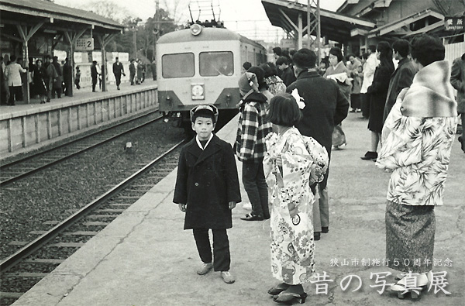
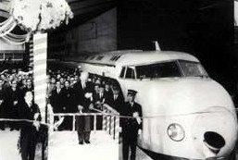
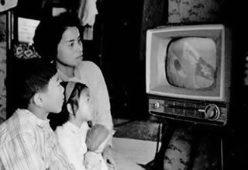

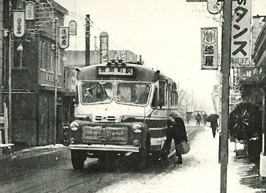
Economic Development of Japan
No.10 The High Growth Era

Slide 2
Postwar High Growth
Mid 1950s to early 1970s
Favorable global conditions for Japan’s postwar catch-up
- Pax Americana: US-led global economic growth & stability
- Trade expansion & liberalization under fixed exchange rates
Combined private and public effort for industrialization
Rationalization (1950s)—new technology and investment for productivity & cost reduction
Quality and productivity movement
MITI and industrial policy
Labor market and SMEs
Rising living standards & consumption boom
Environmental damage

Slide 3
Avoiding Middle Income Traps
Post WW2 Japan did not fall into a middle income trap and could attain high income by around 1970.
  Productivity promotion & innovation were strong and institutionalized (private dynamism with policy support)
  Coping effectively with negative aspects of growth
  Managing macro stability in the process of re-integration
East Asia today—some countries are worried about MITs
  China: “New Normal” (growth slowdown); lack of political reform; social policies needed to cope with growth evils (income gaps, corruption, pollution, property bubbles…)
  Malaysia: achieved upper middle income with reasonably good policy, but indigenous entrepreneurship remains weak
  Thailand: achieved upper middle income but need innovation
  Vietnam: achieved lower middle income, but policy and private dynamism remain weak

Slide 4
Growth & Social Policy: East Asia’s Successful Pattern
Economic growth
START
Growth policy by developmental state
Emergence of new problems
Income & wealth gaps, environmental damage, congestion, cultural change, land & stock bubbles, macro instability, corruption…
Social stability & popular support
Exit: 20-30 years later
Maturity of middle class and political aspiration
Social policy
More democratic high-income society
FINISH

Slide 5
Post WW2 Real Growth
P.162
Shift from political to economic agenda
Yen floats
2nd Oil Shock
1st Oil Shock
Bubble collapses

Slide 6
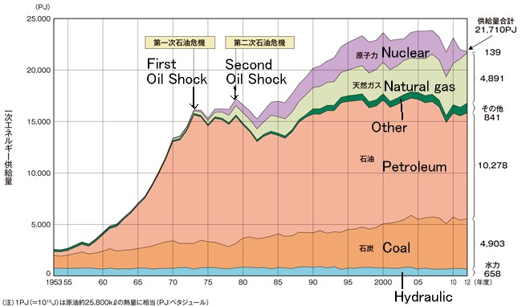
Primary Energy Sources 1953-2012
Unit: Peta Joule (=equivalent to 25,800kl of crude oil)
Source: Nuclear Power and Energy Databook, 2015.

Slide 7

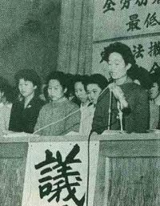
Rationalization 合理化 (1950s)
PP.162-65
Korean War inflation reduced Japan’s cost competitiveness, especially coal & steel.
Competitiveness was regained by investing
in large-scale production and new technology.
Industry must exit if uncompetitive (coal).
Funds: private company profits from the
Korean War boom.
Tight macroeconomic policy under a fixed
exchange rate to force rationalization.
Economic White Paper 1956 (MITI): “We are no longer in the postwar period”—the recovery phase is over, new sources of growth must be found (liberalization & integration are not enough).
Anti-rationalization negotiation, 1955
Anti-rationalization rally, 1961

Slide 8
Examples of Rationalization
Product | Cost | Method
Pig iron | - 4% | Pre-treatment of materials
Steel making | -10% | Large-scale open hearth furnace using oxygen
Flat steel | - 27% | Comparison of continuous casting and traditional equipment
Steel pipe | - 30% | Comparison of Fretz-Moon method and old seamless pipe making method
Oil refinery | - 15% | Comparison of latest and traditional method
Rayon fiber | - 25% | Comparison of continuous & traditional method
Ammonium sulfate | - 21% | Joint production of urea
Cost reduction of industrial materials was achieved by investing in new technology and/or large production capacity.
Sources: Postwar History of the Steel Industry; Industrial Rationalization White Paper.

Slide 9
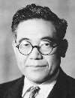
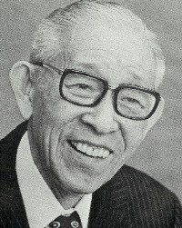
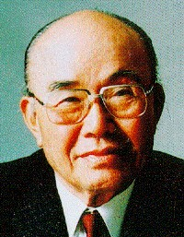
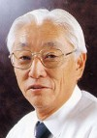
Monozukuri (Manufacturing) Spirit
PP.65, 179-181
Mono means “thing” and zukuri (tsukuri) means “making” in indigenous Japanese language.
It describes sincere attitude toward production with pride, skill and dedication. It is a way of pursuing innovation and perfection, often disregarding profit or balance sheet.
Many of Japan’s excellent manufacturing firms were founded by engineers full of monozukuri spirit.
Kiichiro Toyoda
(Toyota car production)
1894-1952
Konosuke Matsushita (Panasonic founder)
1894-1989
Soichiro Honda
(Honda founder)
1906-1991
Akio Morita (Sony’s co-founder)
1921-1999

Slide 10
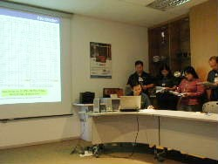
How Japan Developed Kaizen
Phase 1: Introduction (1950s-)
American statistical management (W.E. Deming & J.M. Juran) was introduced to improve productivity & quality.
Private sector, not government, drove this movement. NPOs were created by top executives of large firms.
American style (top-down, statistical) was modified to Japanese style (teamwork, bottom-up & participatory).
Phase 2: National Diffusion (1970s-80s)
Kaizen spread to all Japan, including SMEs, creating a large number of Quality Control Circles (QCCs). Energy-saving component was added.
Phase 3: Globalization (mid 1980s-)
Kaizen spread to ASEAN & rest of the
world, teaching kaizen philosophy & tools
to foreign workers & partner companies.
JICA, APO, AOTS, JODC, JUSE, JPC,
JMA, Kaizen Institute, etc. taught kaizen
abroad.
QCC presentation in Singapore

Slide 11
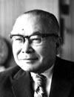
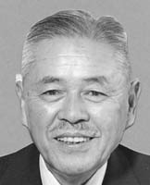
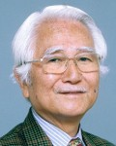
Kaizen is continuous elimination of MUDA – any motion, process, time, inventory, etc. that does not add to product value.
Kohei Goshi (Chairman of Japan Productivity Center) 1900-1989
  “The transformation of mankind’s way of thinking [toward quality and productivity] is like a marathon with no finish line.”
Taiichi Ohno (Toyota engineer & founder of Toyota Production System) 1912-1990
  “Kaizen means finding the best working method with given equipment. Working method is more important than making or buying equipment.”
Masaaki Imai (Founder of Kaizen Institute) 1930-
  “The Kaizen philosophy assumes that our way of life—be it our working life, our social life, or our home life—should focus on constant-improvement efforts.”

Slide 12
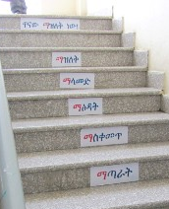
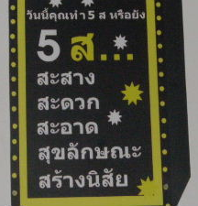

Five S
Action checklist for order, efficiency and discipline at workplace
Seiri (sort) - remove unnecessary things
Seiton (straighten) - keep remaining things in good visibility
Seiso (shine) - clean & shine factory, office, toilets, etc.
Seiketsu (systematize) - keep factory & yourself clean, tidy & agreeable to others
Shitsuke (standardize) – each person must own & make habit of all above
5S is translated variously into many languages.
Exact meaning may differ from company to company, from expert to expert.
First three (3S) are most basic, but difficult to sustain.

Slide 13
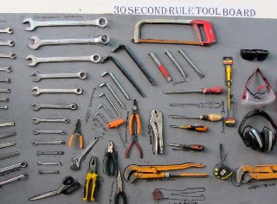
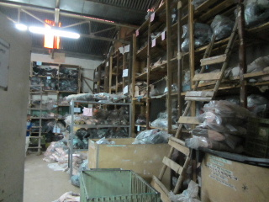
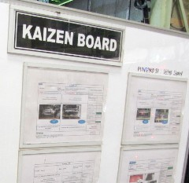
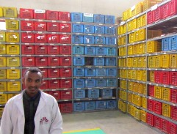
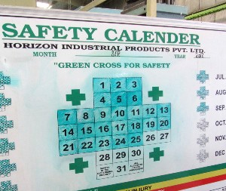
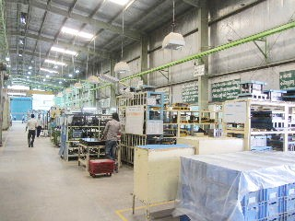
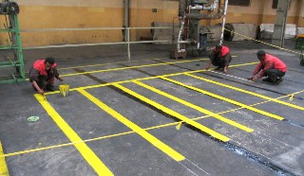
Factory without kaizen
Factory with kaizen

Slide 14
Core NPOs for Quality and Productivity Improvement
Japan Productivity Center (JPC)
  Established in 1955 as a public-interest foundation; received US
  support during 1955-61
  Tripartite collaboration: govt., business, and labor unions
  Main role: productivity improvement (leading Productivity Movement)
  (➔supporting Singapore’s Productivity Movement under JICA project)
Union of Japanese Scientists and Engineers (JUSE)
  Established in 1946, as an incorporated foundation
  Main role: quality improvement (“Deming Prize”, QC Circles)
  (➔supporting Burkina Faso (QCC) under WB/Japan PHRD fund project)
Japan Management Association (JMA)
  Established in 1942, as an incorporated association
  Main role: noritsu (efficiency) improvement, management innovation

Slide 15
Role of Private Sector Organizations in Introduction, Development and Diffusion of Foreign Technologies
Private Sector
Organizations
(JPC, JUSE, JMA, etc.)
US & European
Countries
Private Companies
(Technology Transfer)
(Technology Transfer)
Dispatch of study
missions to US & Europe
Invitation of foreign
advisors
Translation of foreign
literature into Japanese
<To Learn>
Study on adaptability of
new technology (by
committees and working
groups: industry-govt.-
academia joint research)
Trial application and
modification of techno-
logy (pilot projects)
<To Test & Modify>
Guidance and advices
Education and training
Qualification and
certification system
Award system
Enlightenment and
movement
<To Diffuse>
Source: Adapted from Tsuyoshi Kikuchi “The Roles of Private Organizations in the Introduction, Development
and Diffusion of Production Management Technology in Japan” (original paper published in the Bulletin of
the Graduate School of International Cooperation Studies No. 4, 2011, Takushoku University).

Slide 16
Study Missions Sent Abroad by JPC (1955-60)
A large number of study missions were sent abroad and their
findings were disseminated widely.
Different types of missions were organized for top management, industry
groups, special professions, labor unions, SMEs, etc.
Fiscal year | Missions | Participants | Missions | Participants | Mission briefings | Participants of mission briefings
1955 1956 1957 1958 1959 1960 | 15 27 43 62 75 84 | 174 307 430 652 749 821 | 5 0 4 12 13 15 | 58 0 46 141 137 154 | 33 130 180 98 74 11 | 10,020 33,960 27,420 12,177 7,894 1,740
Total | 306 | 3,133 | 49 | 536 | 526 | 93,211
Of which SMEs
Source: History of Trade and Industry, Vol. 6, Edited by the Ministry of Trade and Industry
(original data come from various reports of the Japan Productivity Center)

Slide 17
MITI and Industrial Policy
PP.170-74
Foreign scholars depicted MITI as the command post of Japanese industries—Johnson (1982), Okimoto (1991).
Japanese officials and researchers often deny this view; MITI was only supplementing the market mechanism.
Empirical studies on MITI policies are inconclusive.
Some issues for today’s developing countries:
  --Government’s lack of knowledge and political capture (the doctrine of neoclassical political economy)
  --Excess competition under increasing returns, copy production
  --Impossibility of infant industry promotion under accelerated integration, WTO and FTAs/EPAs
  --State capability building and the scope of industrial policy
  --New search for the sources of growth (esp. Africa) vs. traditional IMF/WB policies, governance emphasis

Slide 18
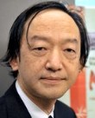
MITI’s Industrial Policy in the 1950s & 1960s
Prof. Tetsuji Okazaki, Nikkei Shimbun, July 15, 2016
Policy finance, tax incentives and R&D support were major industrial measures:
Exim Bank & Japan Development Bank were created for policy finance.
Enterprise Rationalization Promotion Law (1952) subsidized rationalization and R&D.
Foreign exchange budget allocation was used for promoting certain sectors and import protection (1950s only).
Power, steel, artificial fiber, automobile and petrochemicals were targeted for expansion, while coal and natural fiber were targeted for downsizing (sectoral targeting was later criticized by the US and abandoned in the 1980s).

Slide 19
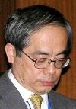
Industrial Policies in Japan
(From Prof. Akira Suehiro’s 2006 Slides)
The fiscal investment and loan program (FILP, p.165fn) promoted trade and industry until early 1960s
Loans by Japan Development Bank and Exim Bank were relatively small, but had two important effects
  --Catalyst for larger commercial bank loans
  --Information sharing between business and government
Cooperative policy formulation and implementation
The “return match game” and learning effect—firms could apply many times for JDB and SME loans
➔ Japan’s industrial policy helped to develop the market mechanism rather than distorting the market.

Slide 20
Industrial Policies in Japan (1) FIL
＊What is a FIL (fiscal investment and loans) ?
→the policy of concentrating social money into the hand of the government, and intentionally allocate these public money for the sake of catch-up industrialization (modernization of life and upgrading of industrial structure).
(1) Monetary sources; see Table 1: Ministry of Finance, Fiscal Fund Bureau →postal deposits, pension funds, postal life insurance fund etc.
(2) Purposes of FIL; see Table 2
→①infrastructure for life; ②industrial infrastructure; ③synchronized promotion of trade and industry
(3) Weight of fiscal finance (policy money) in outstanding loans Table 3.
→commercial banks vs, JDB

Slide 21
Table 1 Monetary Sources of FIL

Slide 22
Table 2 Purposes of FIL by Category

Slide 23
Table 3 Outstanding Loans by
Commercial Banks and Fiscal Finance

Slide 24
Industrial Policies in Japan (2)
Structure and Mechanism
(1) Policy Planning :
*Industrial (Rationalization) Councils at targeted industries and strategic issues. study group → joint group across the Ministry → the Councils.
Information sharing system among the line office (MITI, MOF etc) = business associations = Liberal Democratic Party (LDP) = academicians/ related organizations.
→modernization of specific industries and improvement of international competitiveness.
(2) Flowchart of Long-term Loans for Private Firms:
＊*postal deposits →MOF Fiscal Fund Bureau → Japan Development Bank (JDB 1951) → screening by JDB → decision of loans.
(3) Division of Labor between JDB and MITI:
*JDB: loans, advice to management, accounting, cost control
*MITI, Machine Industry Bureau: advice to technology

Slide 25
Figure 4 Mechanism of FLI and
the Role of MITI and JDB
Policy
Implementation
Fiscal Finance
Policy Making

Slide 26
Industrial Policies in Japan (3)
Promotion of the Machine Tool Industry
*Promotion of Machine Tool Industry, 30 years from 1956 to 1985.
1956-61: Temporary Measure for the Promotion of the Machinery Industry Law (A1) →machine tool, auto parts
1957: Temporary Measure for the Promotion of the Electronics Industry Law (B)
1961-65: Extension of next five years of (A１) =(A2)
1966-71: Further extension of (A2) = (A3)
1971-77: Temporary Measure for the Promotion of Electronics and Machinery Industries Law (integration of A3 with B)
1978-85: Temporary Measure for the Promotion of the Information Machinery Industry Law

Slide 27
Industrial Policies in Japan (4)
Return-match Game and Learning Effect
＊How to Enhance the International Competitiveness of Japanese Firms (especially SMEs) through a tool of Fiscal Finance ?
*screening procedures were twice per year. Firms could re-apply to JDB’s loans even if they failed in examining process.
Investment promotion in other Asian countries: trial was principally once, no chance for firms which failed in getting promotion.
*Company A applied to JDB with its long-term investment loans
→JDB examined its application →the JDB ordered Company A to improve management and accounting, while the MITI also ordered it to improve production technology and equipments. →If Company A failed, it revised its application and submitted JDB again.
Worth of noting: Learning effects on firms in the process of interaction with the JDB and the MITI.

Slide 28
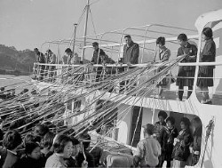
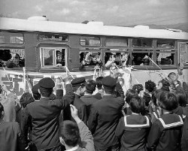
Labor Surplus Ends around 1960
PP.177-78
Job offer/job seeker ratio
(Public job matching service)
Wage Gap by Employment Size
(Large firms’ wage=100)
Unemployment Ratio
Golden Eggs—
some left,
others stayed

Slide 29
Internal Labor Migration Model
Lewis, Fei-Ranis, Harris-Todaro
Modern Sector
Traditional Sector
Formal jobs
(factories, shops, offices)
Informal jobs
Unemployment
Poverty
Surplus labor
Seasonal work
Mutual help for
survival
Labor
migration
Permanent
Seasonal
Temporary
Irregular
Pool of Underclass
Rural Villages
Urban Centers
Not all migrants can find jobs. Most of them go to the unstable informal sector or join the pool of the unemployed.

Slide 30
Japanese SMEs and “Dual Structure”
Large firms
High & stable salary
Life-time employment
Parent-subsidiary relation
Migration
Low wage
Job insecurity
Exploited by large firms
Agriculture
Manufacturing SMEs
SMEs’ problems—low productivity, low wage, job insecurity ➔ SME Policy for protecting weak SMEs & their workers
As the labor market tightened around 1960, the wage gap began to narrow. Government also subsidized farmers.
Today, high-tech SMEs are considered as the source of Japanese competitiveness (but not all of them). Policy focus shifted to creation of champion SMEs.

Slide 31
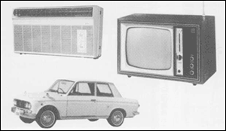
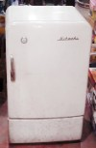

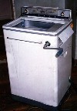
Consumption Boom—Cause or Effect?
P.185
Three C’s
(1960s)
Three Divine Devices (late 1950s)
Household Ownership Ratios of Consumer Durables

Slide 32
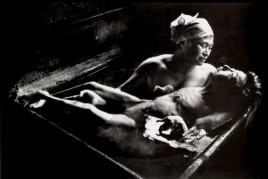
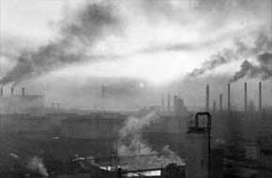
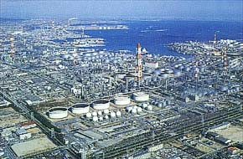
Four Major Pollution Lawsuits
P.177
Case | Accused | Ruling
Minamata Disease (organic mercury in sea water) | Chisso Corp. | Plaintiff wins in 1973
Itai-itai Disease (cadmium in river water) | Mitsui Kinzoku | Plaintiff wins in 1972
Niigata Minamata Disease (organic mercury in river water) | Showa Denko | Plaintiff wins in 1971
Yokkaichi Asthma (air pollution by petrochemicals) | Mitsubishi Petrochemicals etc | Plaintiff wins in 1972
Award winning photo of Minamata Disease victim
Yokkaichi 1961
Yokkaichi today

Slide 33
Environmental Policy Shift
High growth caused serious environmental problems-- esp. air and water pollution by factory emissions.
Motorization also caused urban air pollution, noise problems and traffic accidents.
Growth-orientation was accused (“Down with GNP!”) leading to anti-pollution lawsuits & civil movements.
1967 Basic Law on Environment
1971 Environment Protection Agency
Japan now asserts that environment should
not be sacrificed for growth, and the cost
of preventing pollution is much less than
the cost of cleaning it up later (ODA policy)
– no inverted U curve.
Pollution
?
GDP

Slide 34
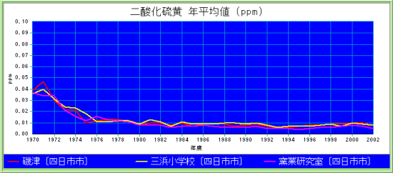
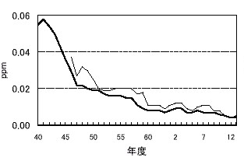
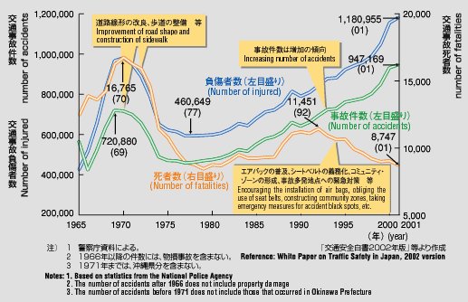
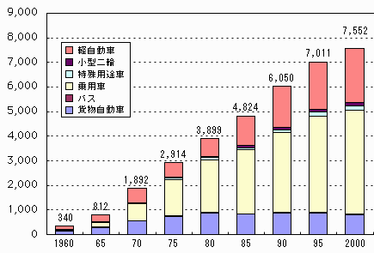
SO₂ Levels in Yokkaichi City
CO Levels in Tokyo
Atmosphere
At factory
70 75 80 85 9 0 95 2000
Traffic Accidents, Injuries, Deaths
Number of Automobiles
X 10,000
Small cars
Passenger cars
Trucks

